Slide 1


The Practice of Treating Patients with Pain and Opioid Use Disorders
Oakland, CA
September 18th, 2018
Andrew A Herring, MD
Associate Research Director, Department of Emergency Medicine
Medical Director Substance Use Disorder Program
Attending Interdisciplinary Pain Program
Highland Hospital—Alameda Health System
Assistant Clinical Professor of Emergency Medicine, UCSF

Slide 2

ED-BRIDGE | Emergency Buprenorphine Treatment
Notes:
I am an ER doc. I trained at Highland hospital in Oakland. Then the opioid crisis hit, and for us this meant daily battles around refilling prescrptions, giving shots of dialuadid, etc…We started with contracts, then threw those out, then finally we realized these opioids were not working, they weren’t helping people recover from their pain but trapping them in dependency and for many worsening pain. We realized it was OK to say “no.” We established guidelines and implemented non-opioid analgesic strategies. With these efforts our use of opioids plummeted by 60-70%. Then in this hallway I met a man complaining of back pain, he wanted norco, he was homeless, and had a history of heroin use, but denied anything recent. He had a normal exam and so I sent him home with a sandwich. He came back a week later, and a colleague did the same thing. Finally he came back a third time, this time his left leg was paralyzed from the infection that had been brewing in his spine. He underwent emergency surgery and regained some use of his leg, but remains in a wheelchair. Incredibly, he is doing well and off heroin at a local clinic.
We were both distracted conflict around opioids. I was setting a boundary, he was pushing back. There was no trust.

Slide 3
ED-BRIDGE | Emergency Buprenorphine Treatment 1
We all treat the same patients

Slide 4
ED-BRIDGE | Emergency Buprenorphine Treatment 2
We want to do the right thing

Slide 5
ED-BRIDGE | Emergency Buprenorphine Treatment 3
Single largest reversal in medical practice ever??
This is not going to be easy

Slide 6
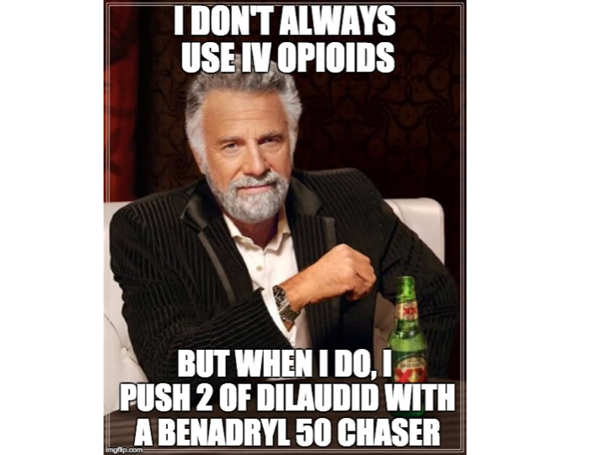
Most interesting man

Slide 7
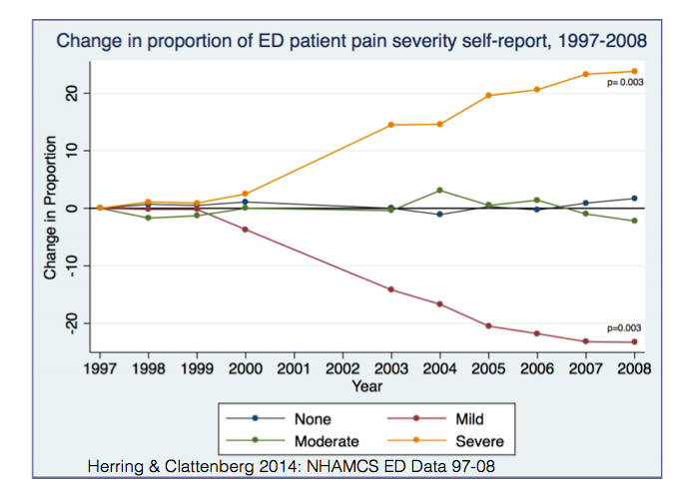
Change in proportion of ED patient pain severity

Slide 8
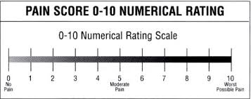
Pain is not a vital sign

Slide 9
Opioid Induced Pain
Notes:
So what’s happening with Alex. Basically as soon as you start to take an opioid you have short-term analgesic effects that are mediated through the mu opioid system this produces pain relief relaxation and euphoria. At the same time dynorphin is released activating microglia promoting the release of neural excitatory inflammatory cytokines and stimulating Opioid receptors— these events promote enhanced pain sensitivity, descending amplification of pain; producing a long-lasting hyperalgesic state.

Slide 10
Opioid induced pain (part 2)
Notes:
From the standpoint of the patient. What you see is short-term peaks of analgesia relaxation euphoria, as the counterbalancing hyperalgesia increases the duration of benefit from the mu agonism decreases. In addition the patient developed tolerance to the mu agonism. This leads to the paradox of escalating doses resulting in worsening overall pain. Unfortunately the tolerance to the analgesic effects tends to develop more strongly than the tolerance to respiratory depression. This results in patients being stuck chasing very short-term moments of relief from unrelenting pain with doses extremely close to the threshold for critical respiratory depression. This is the fundamental pathway for opioid overdose and death.

Slide 11
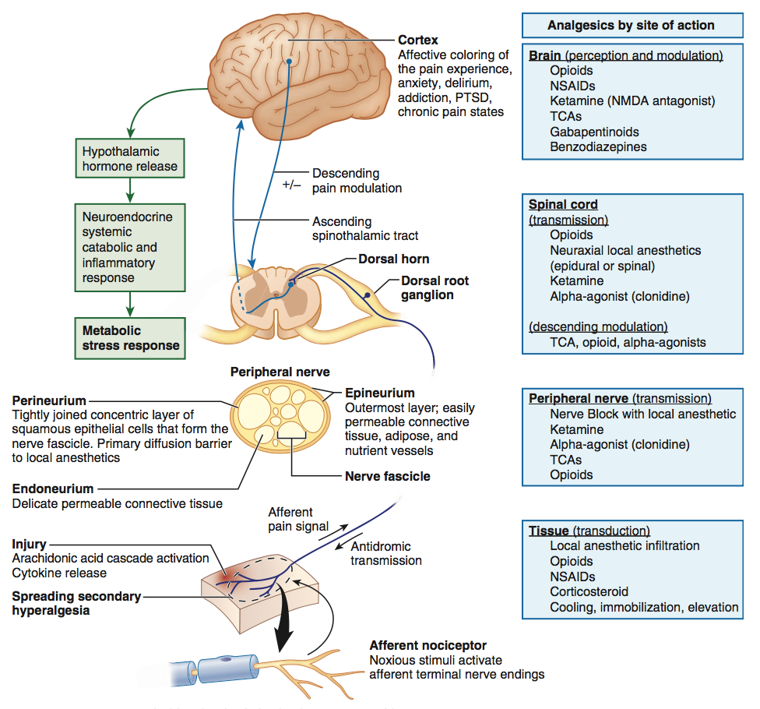
Analgesics

Slide 12
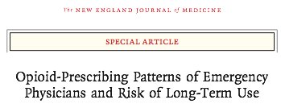
Opioid-Prescribing Patterns
Exposure matters
“even one opioid prescription to a naive patient can be associated with long-term use.”
Micheal Barnett

Slide 13
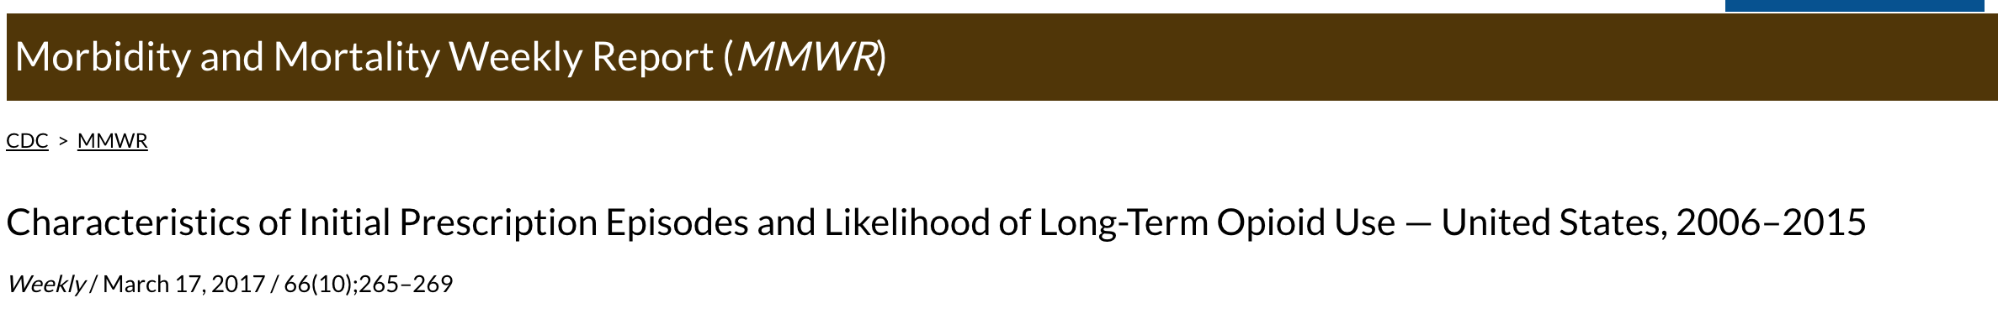
MMWR
Notes:
The rate of long-term use was relatively low (6.0% on opioids 1 year later) for persons with at least 1 day of opioid therapy, but increased to 13.5% for persons whose first episode of use was for ≥8 days and to 29.9% when the first episode of use was for ≥31 days.

Slide 14
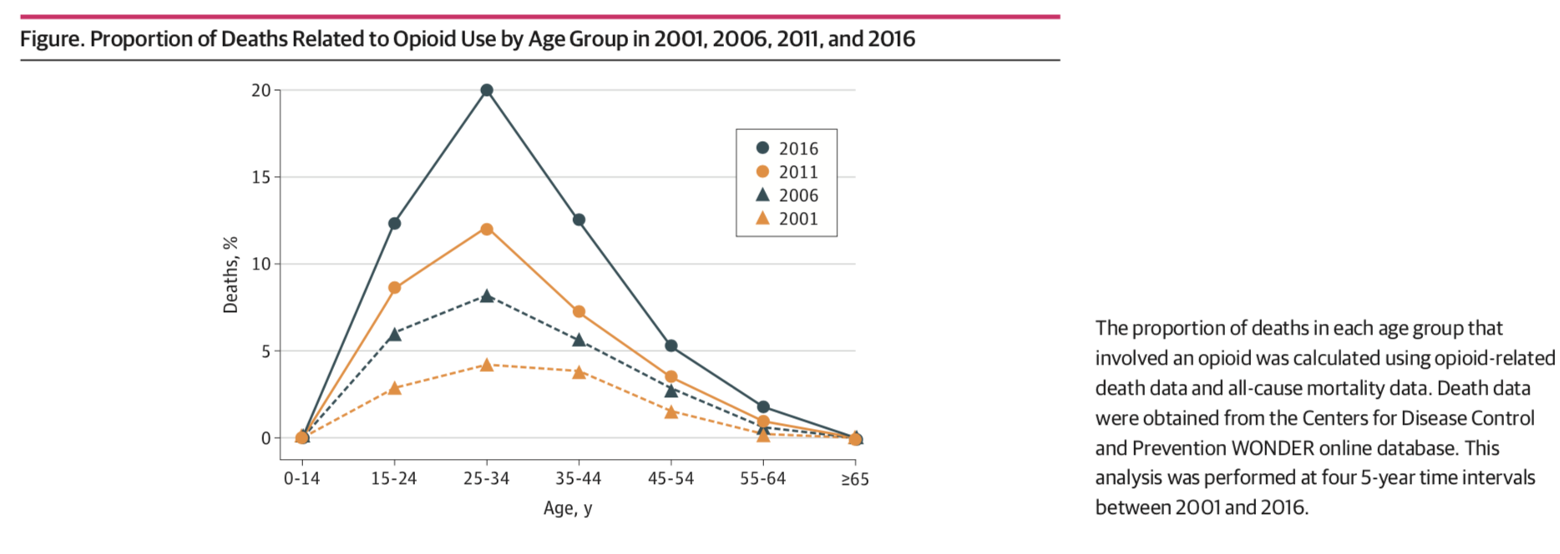
ED-BRIDGE | Emergency Buprenorphine Treatment 4
Institute for Human Data Science titled, "Medicine Use and Spending in the U.S.: A Review of 2017 and Outlook to 2022."(www.iqvia.com)
Notes:
There were 23.3 billion fewer morphine milligram equivalents (MME) dispensed

Slide 15
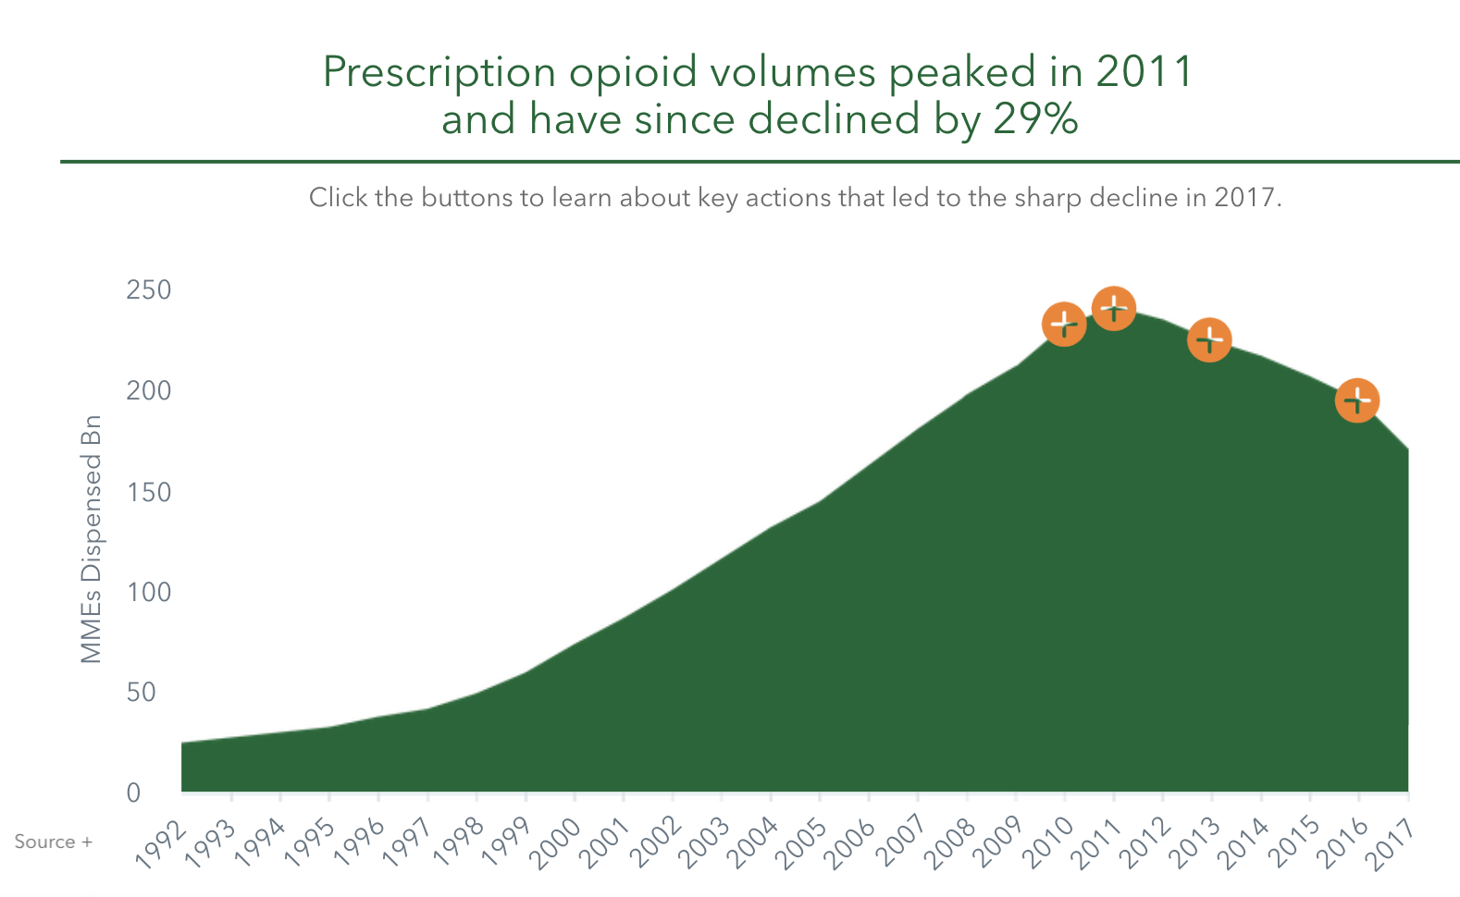
ED-BRIDGE | Emergency Buprenorphine Treatment 5
23.3 billion fewer morphine milligram equivalents (MME) dispensed by 2017
Institute for Human Data Science titled, "Medicine Use and Spending in the U.S.: A Review of 2017 and Outlook to 2022."(www.iqvia.com)
Notes:
There were 23.3 billion fewer morphine milligram equivalents (MME) dispensed

Slide 16
ED-BRIDGE | Emergency Buprenorphine Treatment 6
Notes:
There were 23.3 billion fewer morphine milligram equivalents (MME) dispensed

Slide 17
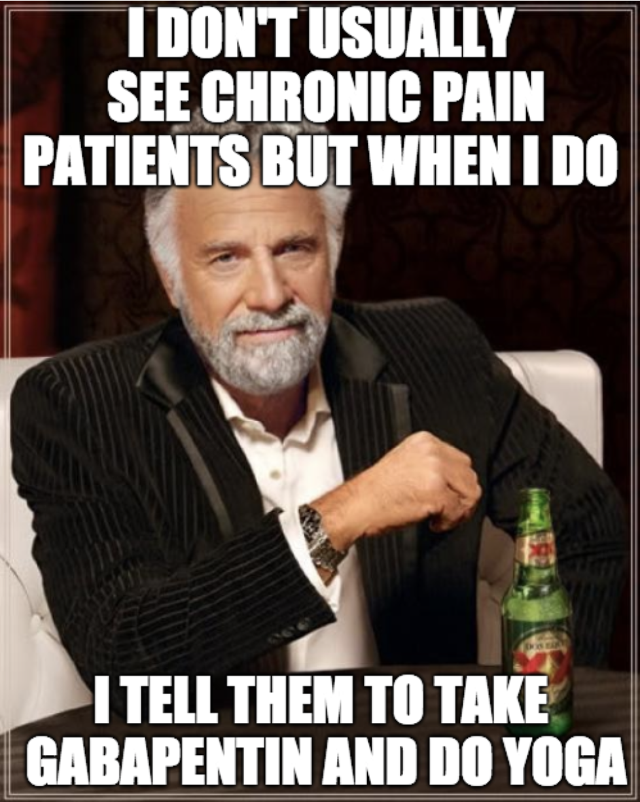
Most interesting man (again)

Slide 18
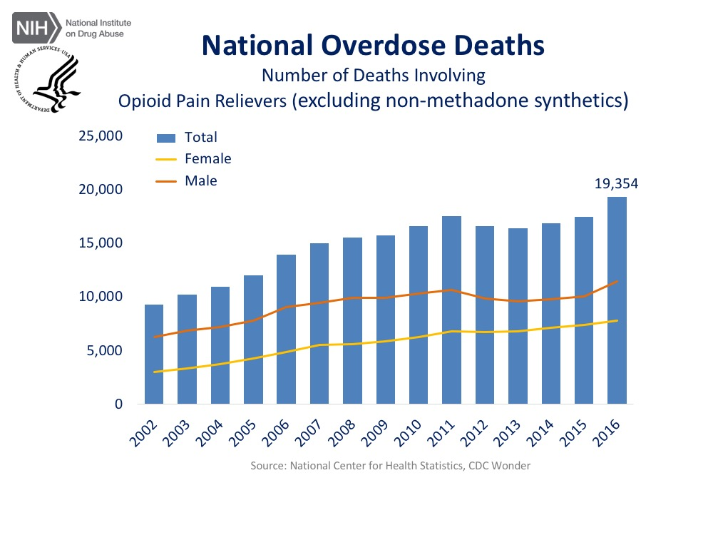
National overdose deaths have increased

Slide 19
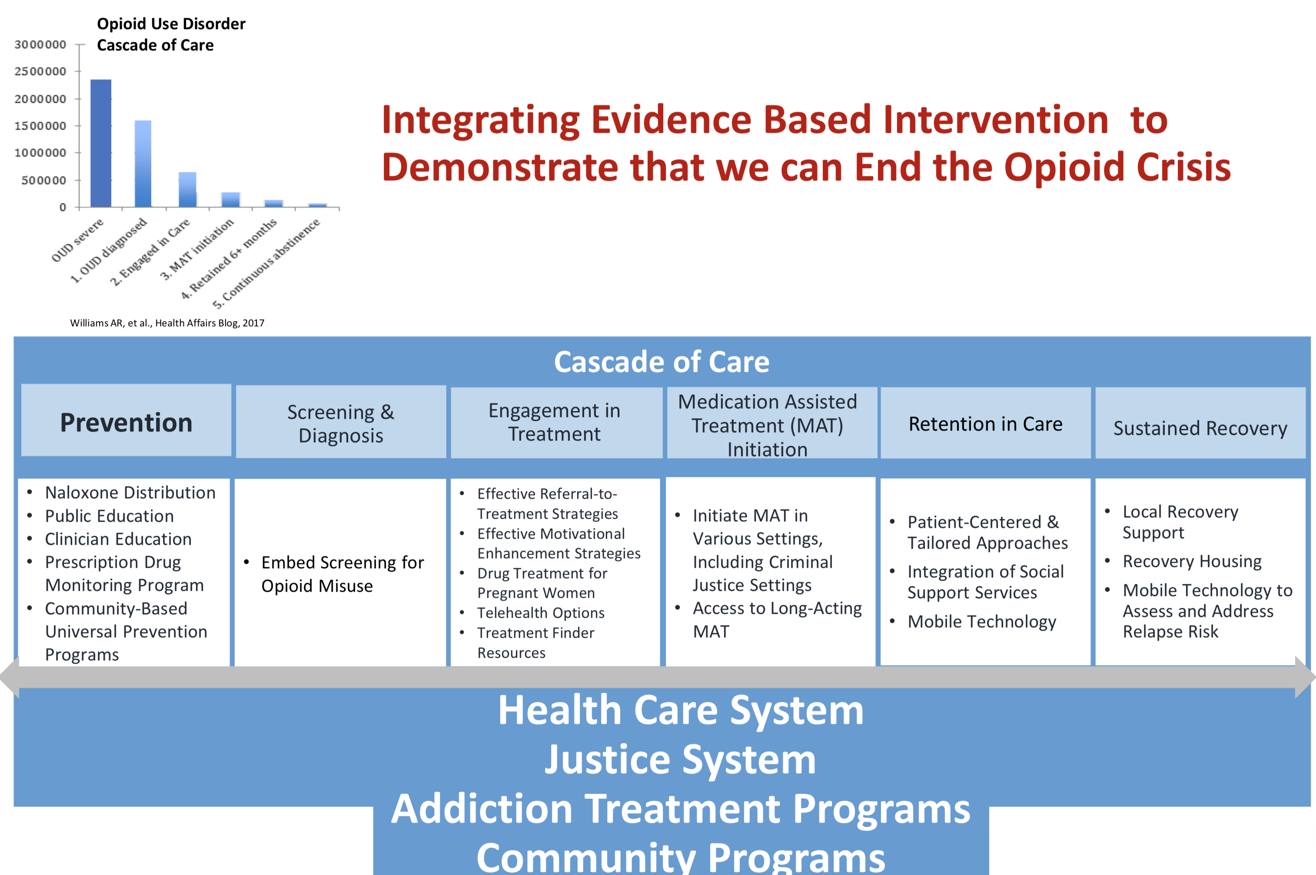
ED-BRIDGE | Emergency Buprenorphine Treatment 7

Slide 20
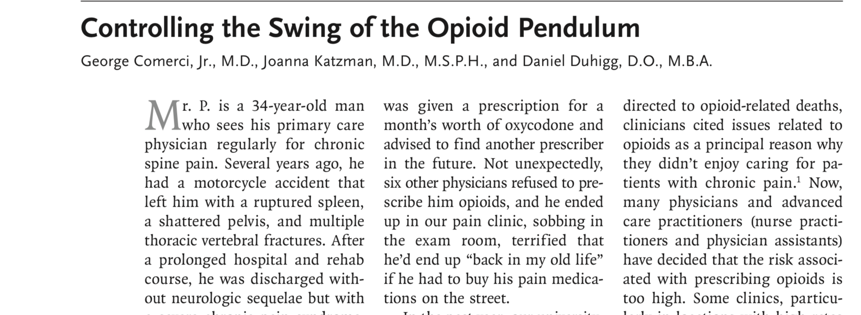
ED-BRIDGE | Emergency Buprenorphine Treatment 8

Slide 21
ED-BRIDGE | Emergency Buprenorphine Treatment 9
First, all clinicians can improve their knowledge about evaluating and treating chronic pain.
Second, clinicians can consider transitioning patients from risky opioid regimens to safer buprenorphine treatment for chronic pain.
Third, clinicians can adopt risk- mitigation strategies for patients taking opioids.
Physicians have an obligation to learn how to diagnose oud and develop strategies to address it.
Finally, physicians and advanced care clinicians can under- go brief training (8 and 24 hours, respectively) to obtain an “X” waiver on their DEA license so they can use buprenorphine to treat OUD.
Similarly, take-home or co-prescription of naloxone for patients taking any opioids should be routine.

Slide 22
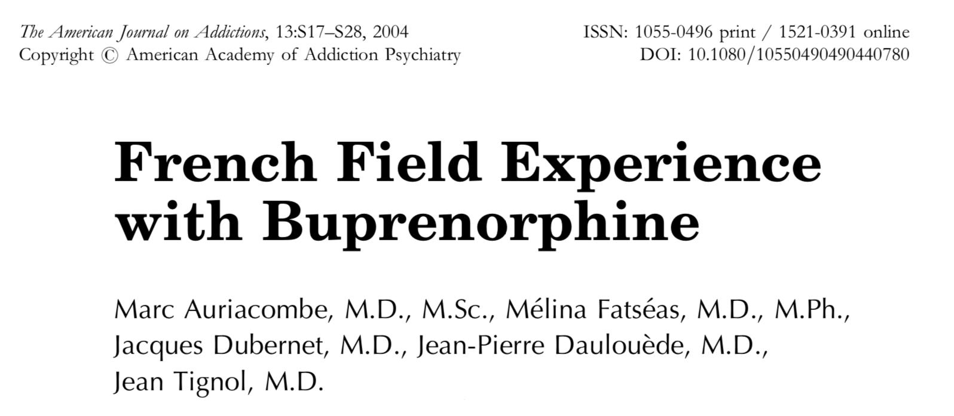
ED-BRIDGE | Emergency Buprenorphine Treatment 10

Slide 23
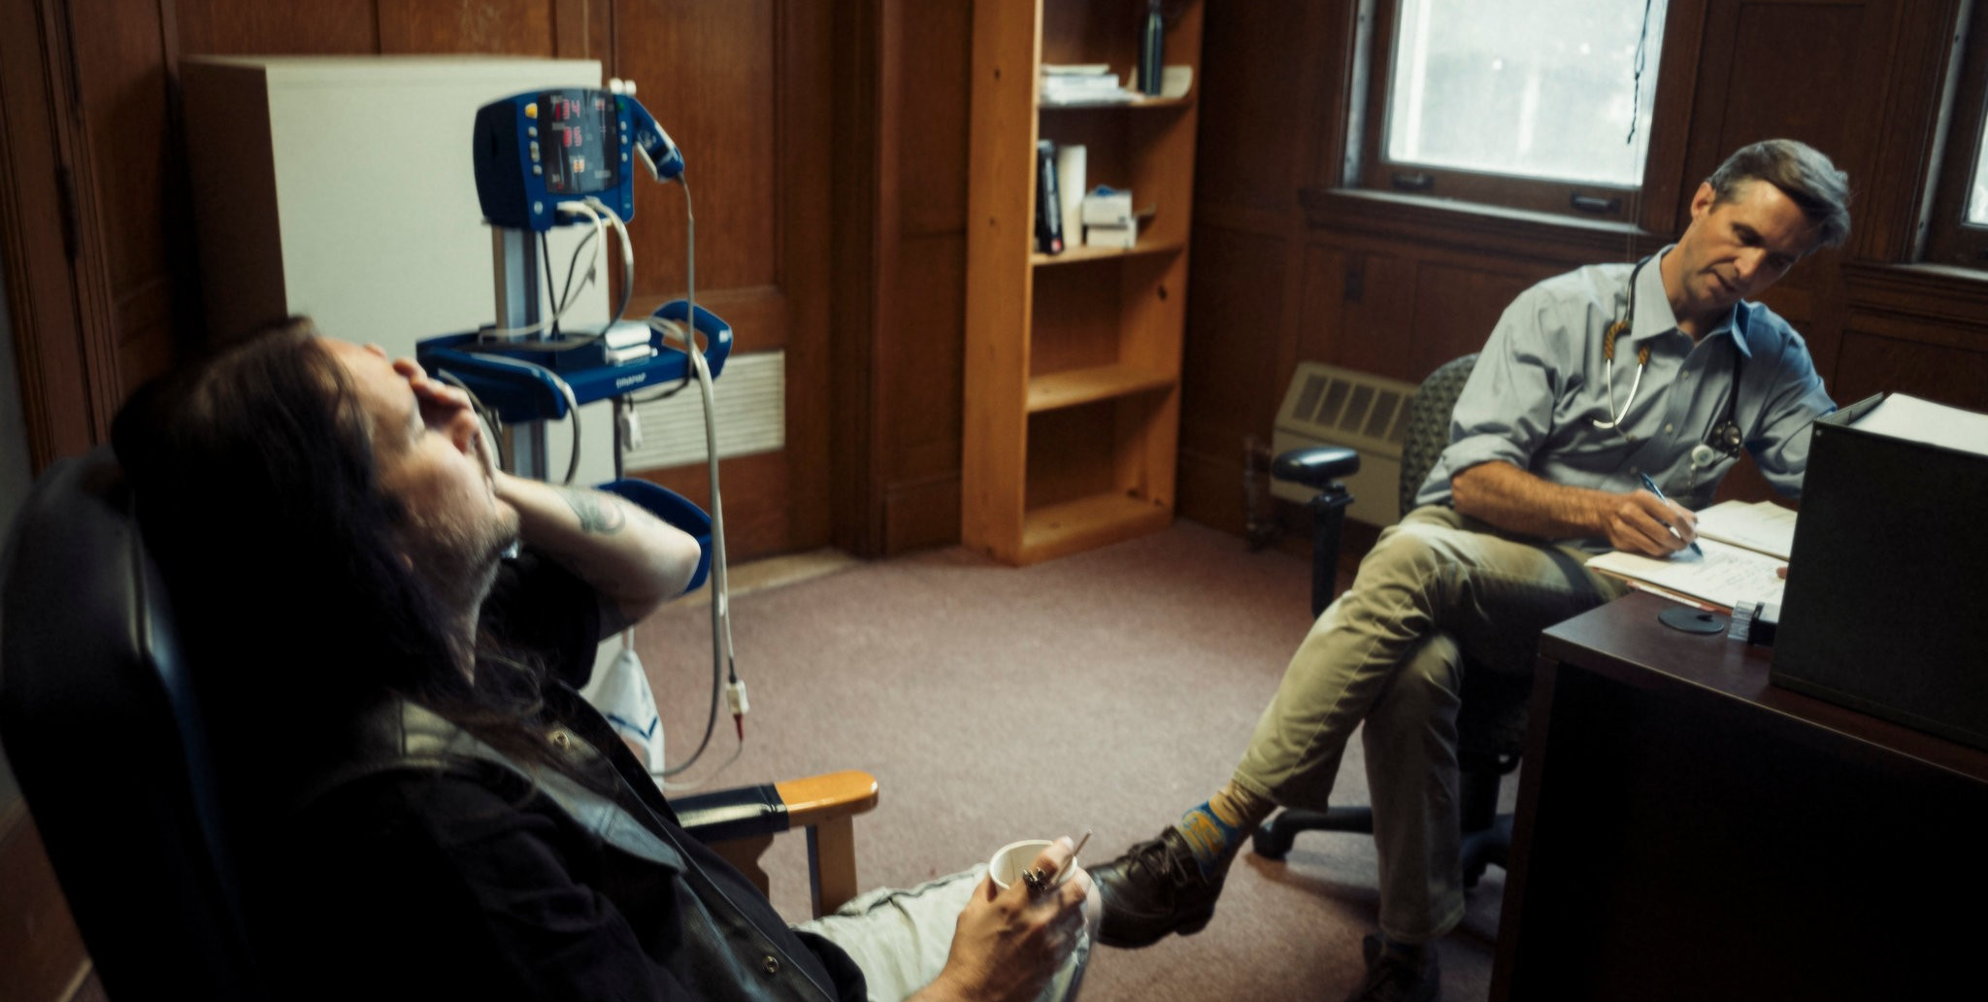
ED-BRIDGE | Emergency Buprenorphine Treatment 11
Notes:
This lack of trust, this fear of persecution for a medical disease. I was increbibly lucky that some amazing and compassionate people such as Amy Smith lead me to a different way of approaching these patients. This is Alex. This is the first patient I ever gave buprenorphine to. It was a revelation, he just laid it out for me…years of heroin use, He made several attempts to quit, and reports a pattern of using up all his dope, then getting desperate as the withdrawal set in and look for relief.
Going back to his dealer meant failure and return to his addiction. So where he turn in the middle of the night??
The nearest ER where he knew the magic words to receive opioids “10 out of 10 pain”
Then with his withdrawal improved he still wanted to complete his detoxification, so he would then report being suicidal and be transferred to the local locked facility.
Contrast this insane waste of resources, with day I met Alex. He had heard about the new program and came in. He was seen in fast track. No labs were drawn, no tests done. He received a script and followed up with a partner clinic 3 days later.

Slide 24
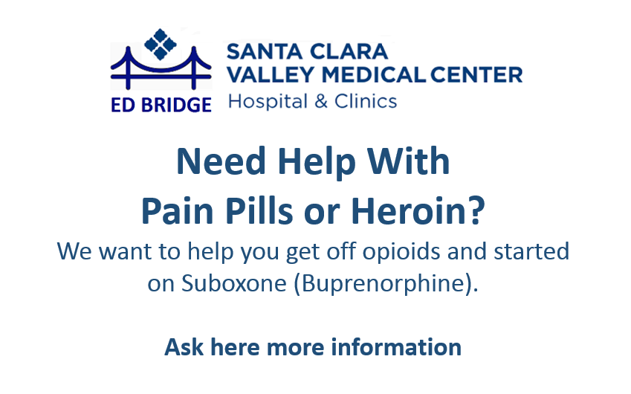
ED-BRIDGE | Emergency Buprenorphine Treatment 12
Notes:
To do this we are going to have to learn French.
Look, I know that Bakersfield is a long way from Paris, but we can learn from their experience.

Slide 25
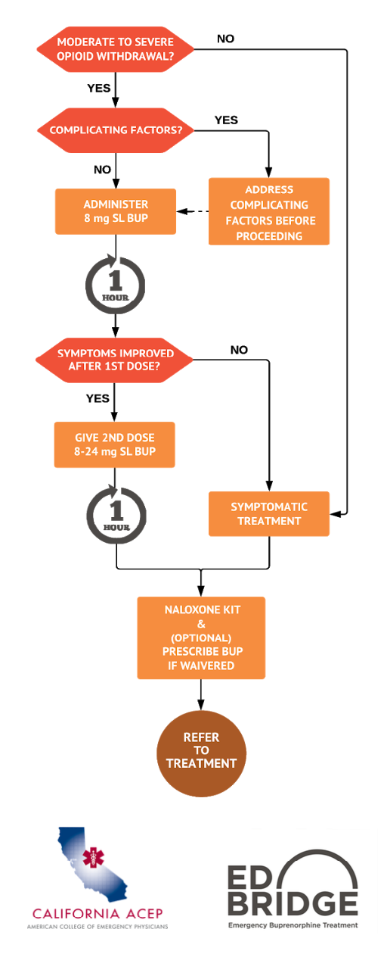
ED-BRIDGE | Emergency Buprenorphine Treatment 13
Started on Norco for a shoulder injury. Want’s to get off, has tried and failed.
Notes:
This lack of trust, this fear of persecution for a medical disease. I was increbibly lucky that some amazing and compassionate people such as Amy Smith lead me to a different way of approaching these patients. This is Alex. This is the first patient I ever gave buprenorphine to. It was a revelation, he just laid it out for me…years of heroin use, He made several attempts to quit, and reports a pattern of using up all his dope, then getting desperate as the withdrawal set in and look for relief.
Going back to his dealer meant failure and return to his addiction. So where he turn in the middle of the night??
The nearest ER where he knew the magic words to receive opioids “10 out of 10 pain”
Then with his withdrawal improved he still wanted to complete his detoxification, so he would then report being suicidal and be transferred to the local locked facility.
Contrast this insane waste of resources, with day I met Alex. He had heard about the new program and came in. He was seen in fast track. No labs were drawn, no tests done. He received a script and followed up with a partner clinic 3 days later.

Slide 26
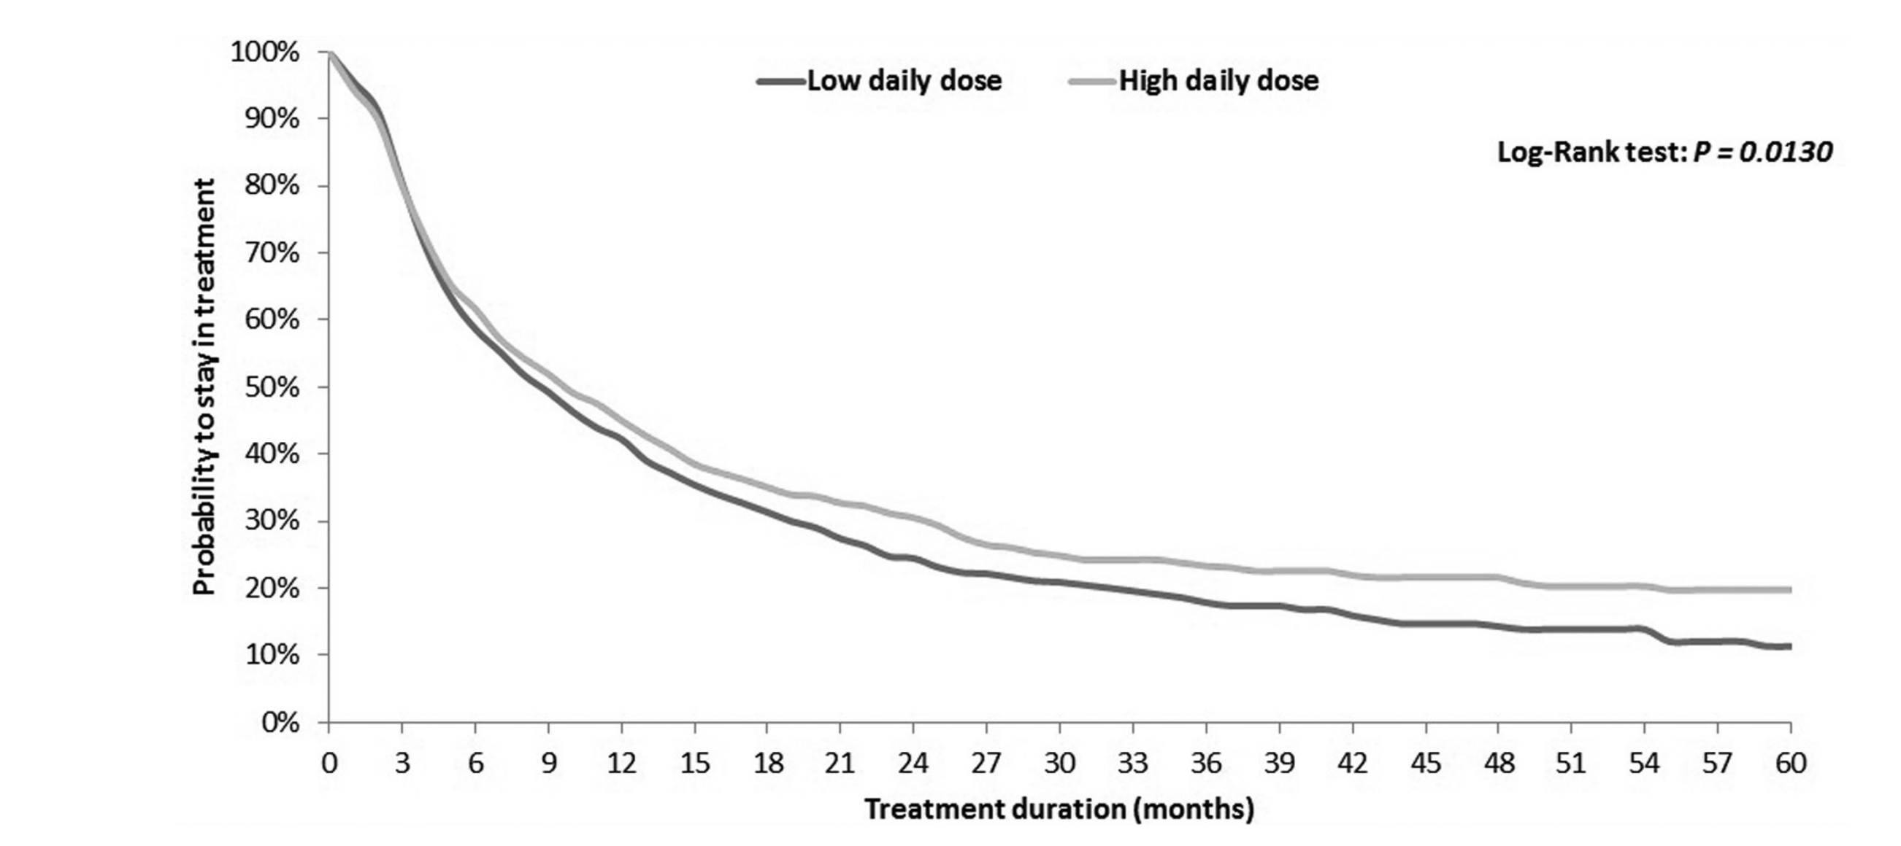
ED-BRIDGE | Emergency Buprenorphine Treatment 14
Second chances
Notes:
We need a buprenorphine first approach. Yes counseling matters, wrap around attention to trauma, mental health, methamphetamine/cocaine/alcohol disorders and housing are incredibly important, but addressing all these various issues cannot be a barrier to opioid substitution. We must allow lean bup programs to take root.

Slide 27

ED-BRIDGE | Emergency Buprenorphine Treatment 15
Notes:
Rhonda struggles with alcohol

Slide 28
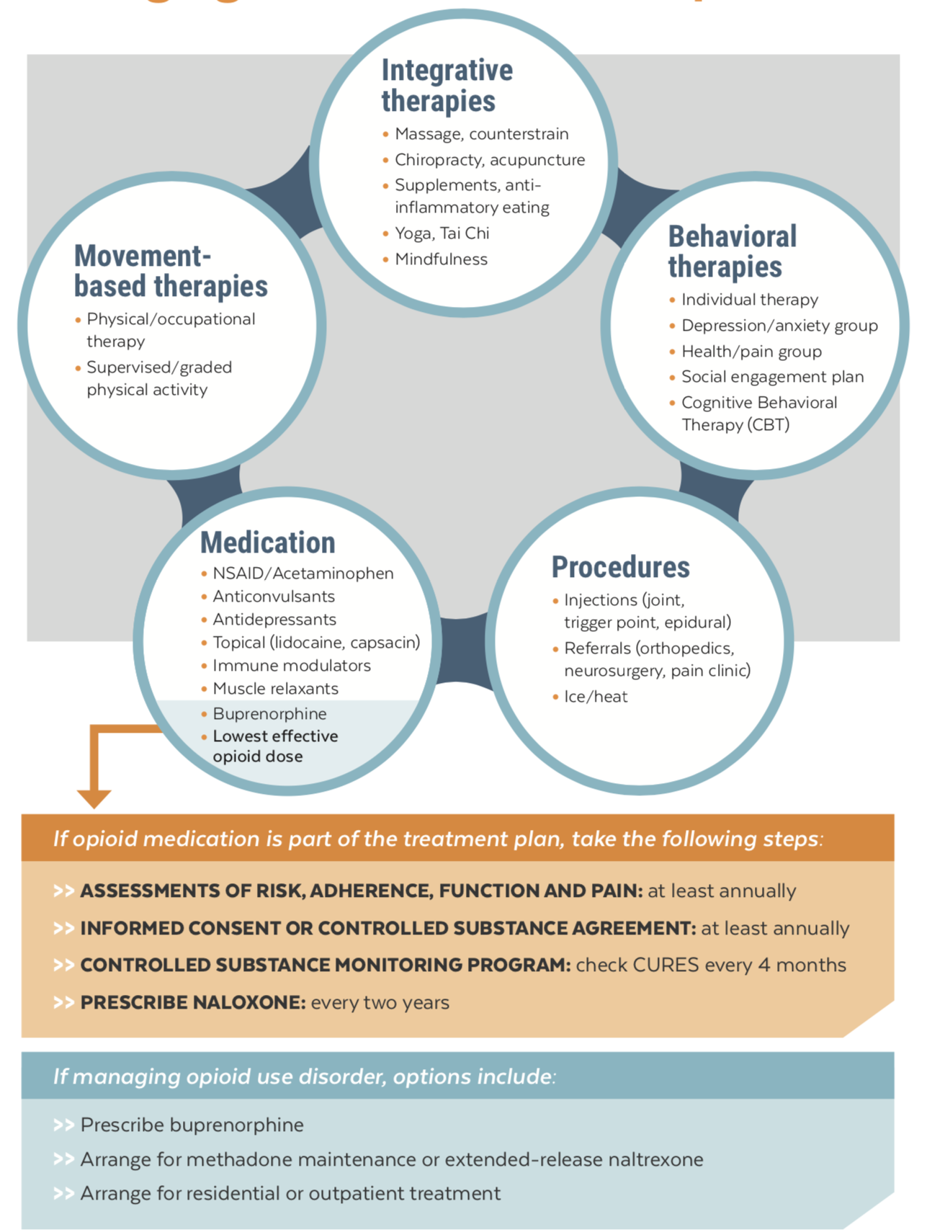
ED-BRIDGE | Emergency Buprenorphine Treatment 16
Notes:
Pregnant woman 85 yo female with COPD and sleep disorder on opioids x 8 years for pain
Chronic low back pain
Remote lumbar reconstructions and L4-5 fusion
On morphine SR 15mg bid + oxycodone 10mg q 4h po (MME = 120 mg)
Pain fluctuates and causes significant distress each day
Nighttime awakenings due to pain

Slide 29
ED-BRIDGE | Emergency Buprenorphine Treatment 17
Address chronic pain risk factors as the primary issue
Stable Circadian rhythm - sleep and eating
Daily exercise
Meaningful social connections
Somatic engagement - touch, movement - Yoga, Tai Chi etc..
Ambition and positive coping
Tobacco!!
Notes:
This lack of trust, this fear of persecution for a medical disease. I was increbibly lucky that some amazing and compassionate people such as Amy Smith lead me to a different way of approaching these patients. This is Alex. This is the first patient I ever gave buprenorphine to. It was a revelation, he just laid it out for me…years of heroin use, He made several attempts to quit, and reports a pattern of using up all his dope, then getting desperate as the withdrawal set in and look for relief.
Going back to his dealer meant failure and return to his addiction. So where he turn in the middle of the night??
The nearest ER where he knew the magic words to receive opioids “10 out of 10 pain”
Then with his withdrawal improved he still wanted to complete his detoxification, so he would then report being suicidal and be transferred to the local locked facility.
Contrast this insane waste of resources, with day I met Alex. He had heard about the new program and came in. He was seen in fast track. No labs were drawn, no tests done. He received a script and followed up with a partner clinic 3 days later.

Slide 30
Opioid Induced Pain (revisited)
Notes:
So what’s happening with Alex. Basically as soon as you start to take an opioid you have short-term analgesic effects that are mediated through the mu opioid system this produces pain relief relaxation and euphoria. At the same time dynorphin is released activating microglia promoting the release of neural excitatory inflammatory cytokines and stimulating Opioid receptors— these events promote enhanced pain sensitivity, descending amplification of pain; producing a long-lasting hyperalgesic state.

Slide 31
Analgesics by site of action

Slide 32
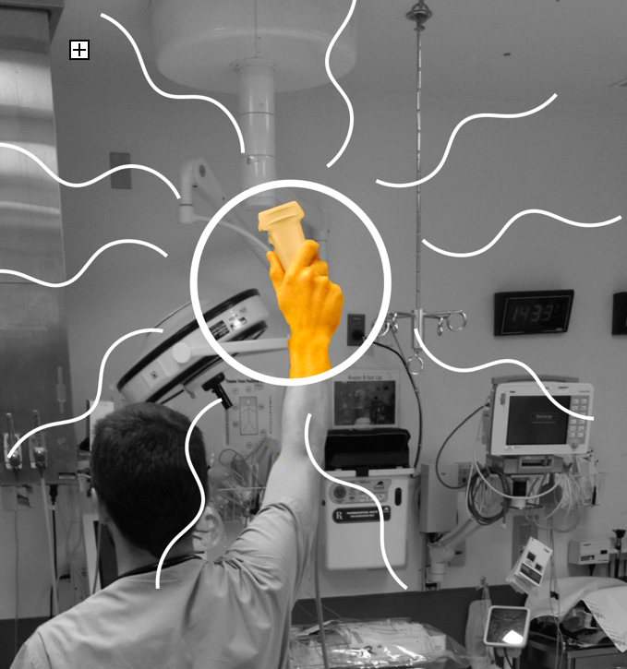
ultrasound

Slide 33

ED-BRIDGE | Emergency Buprenorphine Treatment 18
Notes:
Pregnant woman 85 yo female with COPD and sleep disorder on opioids x 8 years for pain
Chronic low back pain
Remote lumbar reconstructions and L4-5 fusion
On morphine SR 15mg bid + oxycodone 10mg q 4h po (MME = 120 mg)
Pain fluctuates and causes significant distress each day
Nighttime awakenings due to pain

Slide 34
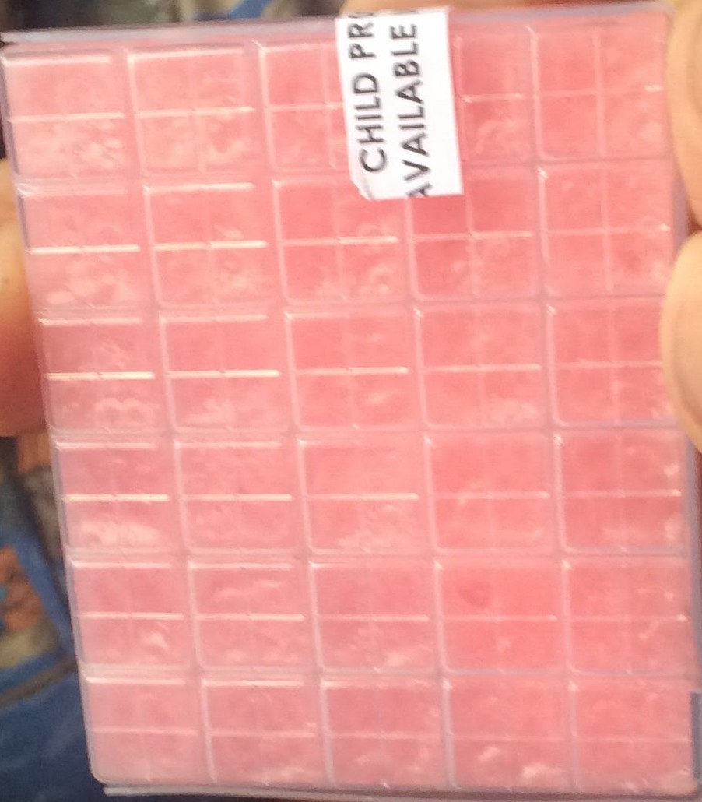
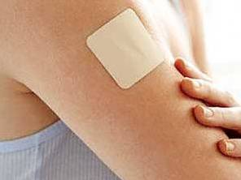
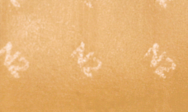
HYBRID (Kornfeld) Method
SMALL dose with transdermal and sublingual buprenorphine
Micro gram Bup patch
1/8 film of 2 mg = 0.25 mg Bup
0.125-0.5 mg Bup troche

Slide 35
Day 1
Buprenorphine
5 ug TD
DAY 0
DAY 1
DAY 1:
Buprenorphine introduced as a transdermal 5 mcg/hr patch
Oxycodone 10 mg po q 4 hr
Morphine SR 15 m g bid
No change of other medications
Notes:
NOTES:
choose of 5mcg vs 20mcg due to age? In part, due to age, but it could also be due to comorbidities or pain or anxiety

Slide 36
Day 2/3
DAY 2/3:
ADDED: 2 more 5mcg/hr TD BUP patches
STOPPED: Long-acting Morphine
CONTINUED Oxycodone 10 mg po q 4 hr continued
ADDED: Oxycodone 5 mg po q 4 hr continued
Buprenorphine
5 ug TD
Buprenorphine
5 ug TD
DAY 2
Oxycodone
5 mg po q 4 hr
DAY 3
Oxycodone 10 mg po q 4 hr
DAY 3:
Ethel experiences a DECREASE in pain
Morphine SR 15 m g bid
Notes:
NOTES:
does pain symptoms help determine timing of transition, or is this mentioned for ?? Absence or reduction of pain is a good indication that the patient is tolerating the transition and it is going at the right pace

Slide 37
Day 4
0.0625 mg BUP
1/2 troch Q 4h SL
0.125 mg BUP
1 troch Q 4h SL
DAY 4:
ADDED:
0.5 compounded buprenorphine troch SL q 4 hours
DECREASED to Oxycodone 10 mg po q 4 hr, instead of 15 mg
Oxycodone 10 mg po q 4 hr
Oxycodone 5 mg po q 4 hr
DAY 5:
INCREASED:
1 compounded buprenorphine troch SL q 4 hours
DECREASED to Oxycodone 5 mg po q 4 hr, instead of 10 mg
5 mg
5 mg
10 mg
10 mg
Oxy
5 mg
Oxy
10mg
DAY 4
DAY 5
Notes:
NOTES: discuss better relative absorption of the troche compared to bup pills and compare transdermal absorption
troche

Slide 38
Day 6
DAY 6:
INCREASED:
2 compounded buprenorphine troch SL q 4 hours
STOPPED Oxycodone
0.125 mg BUP
1 troch Q 4h SL
0.125 mg BUP
1 troch Q 4h SL
2 mg BUP
0.5-1 tab sl qid
DAY 7:
STOPPED: troch and transdermal patch
ADDED: buprenorphine tabs 1 mg SL 4 times daily
5 mg
5 mg
DAY 8:
INCREASED: buprenorphine tabs 2 mg SL 4 times daily
Oxy
5 mg
Patch OFF
DAY 6
DAY 7
Notes:
NOTES:
Are there signs/symptoms that help guide the timing of transition of each daily step? The absence of withdrawal and the gradual reduction of pain is what is ideal - however some patients need to tolerate these symptoms more than others

Slide 39
ED-BRIDGE | Emergency Buprenorphine Treatment 19
First, all clinicians can improve their knowledge about evaluating and treating chronic pain.
Second, clinicians can consider transitioning patients from risky opioid regimens to safer buprenorphine treatment for chronic pain.
Third, clinicians can adopt risk- mitigation strategies for patients taking opioids.
Physicians have an obligation to learn how to diagnose oud and develop strategies to address it.
Finally, physicians and advanced care clinicians can under- go brief training (8 and 24 hours, respectively) to obtain an “X” waiver on their DEA license so they can use buprenorphine to treat OUD.
Similarly, take-home or co-prescription of naloxone for patients taking any opioids should be routine.

Slide 40
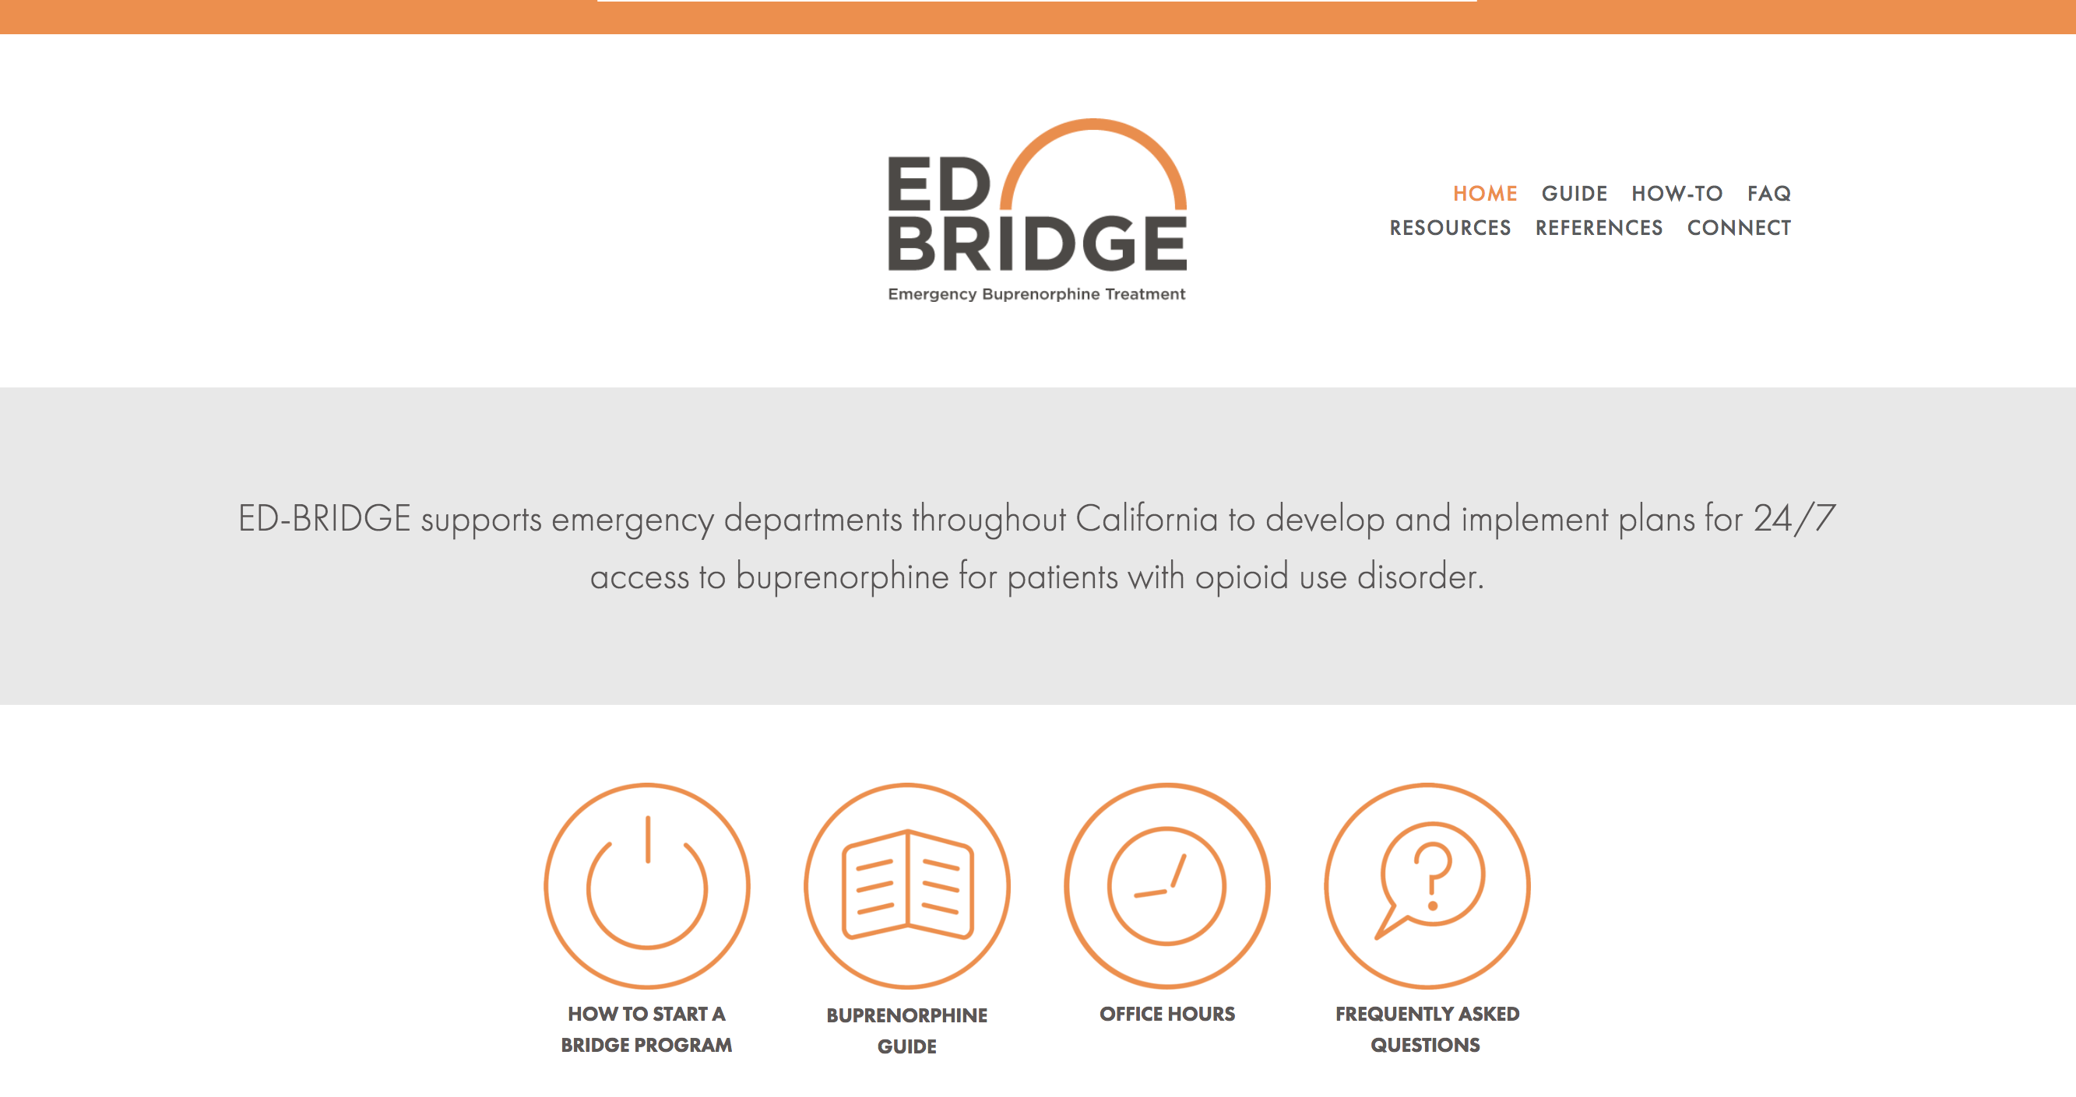
ED-BRIDGE

Slide 41


emails
Andrew.a.herring@gmail.com
Hannah.Snyder@ucsf.edu
Kathy.vo@ucsf.edu

